Slide 1


Age Group Checker: A Simple Python Program
This program categorizes users into age groups. It's a simple Python demo for practical use.
BY: Group 2
Saurav Raj Aryal
Dipti KC
Suraj Gupta
Sajina Dangi
Manjil Shrestha
1

Slide 2

Introduction: What Does It Do?
Captures Age
Categorizes
It takes the user's age as input.
Users are sorted into child, teen, adult, or senior groups.
User-Friendly
The program provides clear, understandable output.
2

Slide 3

Key Features
Easy User Interaction
Simple prompts guide the user for age input.
Robust Error Handling
Input is validated to ensure only numbers are accepted.
Repeated Checks
Users can perform multiple age categorizations.
Clear Output
The program displays the correct age group clearly.
3

Slide 4
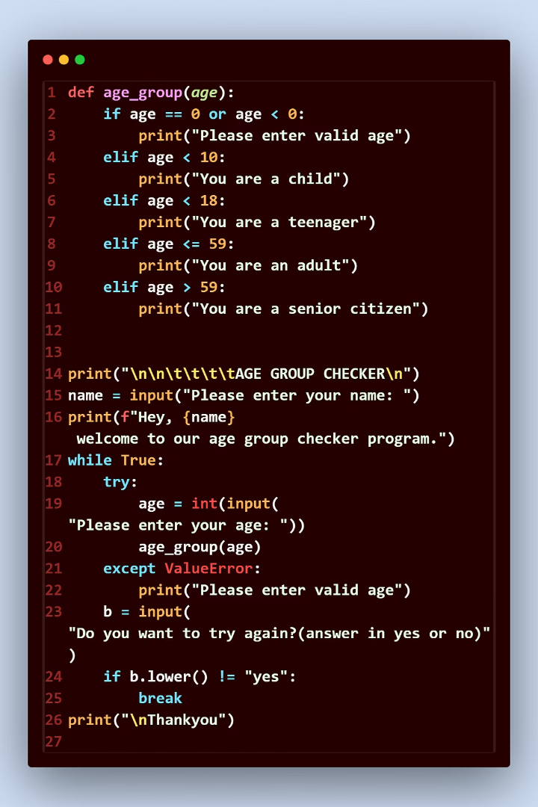



Code Walkthrough: Input
Prompt for Age
age = input("Enter your age: ") collects data.
Convert to Integer
age = int(age) changes text to a number.
Handle Errors
A try-except block manages invalid input.
4

Slide 5




Code Walkthrough: Conditionals
Senior
1
else: print("Senior")
Adult
2
elif age < 59: print("Adult")
Teen
3
elif age < 18: print("Teen")
Child
4
if age < 10: print("Child")
Conditional statements (if, elif, else) classify the age.
5

Slide 6
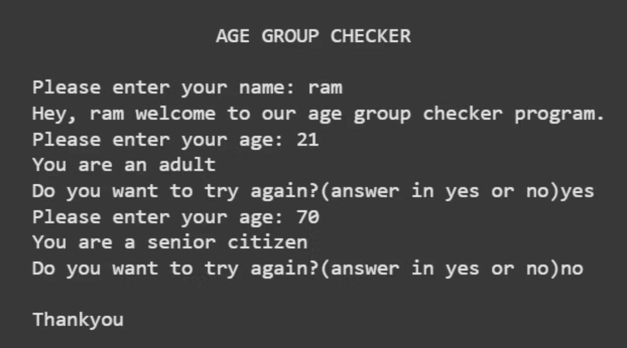
Code Walkthrough: Output
6

Slide 7




User Experience: Running the Program
Execute Script
Run the Python file to begin.
Input Age
Type your age when prompted.
View Classification
See your age group displayed instantly.
Repeat or Exit
Choose to continue or end the session.
7

Slide 8

Conclusion
1
3
Simple Yet Practical
Core Concepts
A straightforward program with real-world use.
Showcases input, conditionals, try and except and loops.
2
Great for Learning
Serves as an ideal Python learning example.
8

